Slide 1
7-1 Areas of Parallelograms and Triangles
M11.C.1 2.9.11.G
Objectives:
To find the area of a parallelogram and a triangle.

Slide 2
Area of a Rectangle
the area of a rectangle is the product of its base and height.
A = bh
Area of a Parallelogram the area of a parallelogram is the product of a base and the corresponding height.
A = bh

Slide 3
A base of a parallelogram is any of its sides. The corresponding altitude is a segment perpendicular to the line containing that base drawn from the side opposite the base. The height is the length of an altitude.

Slide 4
Examples
Find the area of each parallelogram.

Slide 5
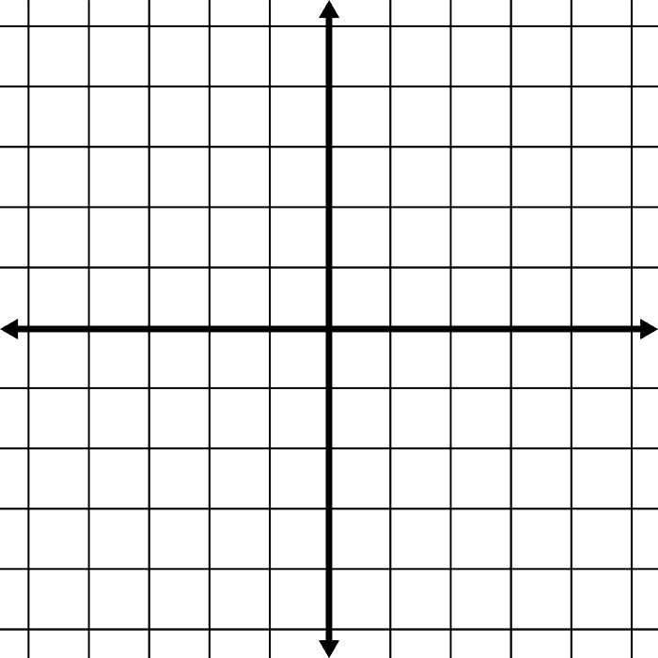
Example: Finding Area in the Coordinate Plane
Find the area of
Parallelogram ABCD
With vertices A (-4, 3),
B(-2,-1), C(3,-1), D(1,3)

Slide 6
Example
For parallelogram ABCD, find CF to the nearest tenth.

Slide 7
Example
Find h.

Slide 8
Theorem: Area of a Triangle
The area of a triangle is half the product of a base and the corresponding height.
A = 1/2bh

Slide 9
Example
Find the area of triangle ABC.
Find the area of triangle ABD.

Slide 10
Homework
Handed In
Page 351 #1-3, 11-13, 15-21

